Slide 1
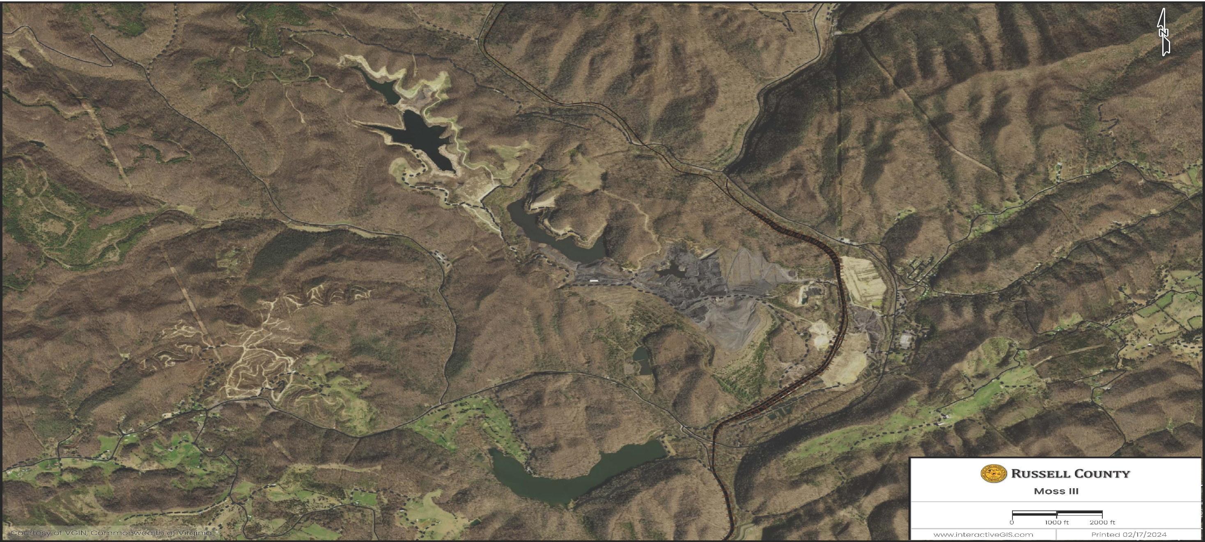
Moss III Landfill Project
Landfill Host Agreement

Slide 2
Project History
End of March/April 2022 (Not on calendar - attended after phone call) - Brief meeting between BOS Chairperson, Legal Counsel, RCR, Resident, and County Administrator. RCR proposed an economic development of MOSS III property for post reclamation use. The discussion included a wide range of possibilities from partnering with Dominion Power (ODP) converting/processing the refuge/coal, lightweight aggregates, rare earth minerals, wind or solar energy, and landfill. At this point, the project was very conceptual, but we had to treat it as a proposed economic development project. Legal Counsel recommended contracting an environmental specialist to conduct a fatal flaw analysis for the site due to the environmental issues. The County receives many economic development proposals and treats them all as viable projects, but many do not materialize.
5/2/22 - BOS Regular Board Meeting - Closed session held to discuss the Moss III Property for potential economic development. Legal counsel requested a closed session to discuss the proposed Moss III Property for lightweight aggregates, rare earth minerals, solar, coal fines, and possible landfill, but still not enough detailed information concerning the property. The discussions were extremely broad in scope at this point, but one point of concern by the board was no matter what project was being proposed, based on the site, there would be environmental concerns. The board approved an advertisement for an environmental specialist to assist the board in evaluating this property with these engineering and environmental concerns.
6/6/2022 - BOS Regular Board Meeting - Closed session held to discuss the Moss III Property. Update on progress only. The Moss III property was discussed but still a conceptual project with environmental concerns.
6/6/2022 - RFQ for Engineering/Environmental Services (Closed) at 3 P.M.
7/27/2022 - Interviewed Thompson & Litton and Potesta. The County Administrator did not want to award contact before more information from the developer. Did not want to pay engineering costs before needed.

Slide 3
Project History
9/12/2022 - RC BOS approved the Potesta Environmental Services Contract to focus on the landfill proposal. Legal Counsel presented the Environmental Consultant Contract and the BOS approved.
12/01/2022 - RC Solar Technical Advisory Committee met to develop the County Solar Ordinance
12/05/2022 - Virginia Energy Meeting to advise the Solar Committee on developing the County Solar Ordinance
12/13/2022 - Solar Committee met to develop the County Solar Ordinance
12/16/2022 - Potesta emailed the Feasibility Report - The report in summary stated, at this point, POTESTA has not identified
any issues that make this site “unpermittable” for use as a landfill.
1/3/2023 - BOS Regular Board Meeting - Closed session held to discuss the Potesta Feasibility Review. More information is needed from RCR concerning Moss III Property.
1/12/2023 - Solar Committee met to develop the County Solar Ordinance
1/15/2023 - Solar Committee met to develop the County Solar Ordinance
3/6/2023 - BOS Regular Board Meeting - Closed session held to discuss the Moss III Project and Potesta Feasibility Review. Potesta Landfill Feasibility Information Report reviewed again. More information is still needed from RCR concerning the Moss III Property.

Slide 4
Project History
3/16/2023 - Solar Committee met to finalize the County Solar Ordinance
4/3/2023 - BOS Regular Board Meeting - Closed session held to discuss the Moss III Project and Potesta Feasibility Review. Potesta Landfill Feasibility Information Report reviewed again. More information is still needed from RCR concerning the Moss III Property. BOS Regular Session - Passed the County's Solar Ordinance
5/1/2023 - BOS Regular Board Meeting - Closed session held to discuss the Moss III Project and Hire Special Counsel. The County Attorney presented hiring a Special Counsel for the legal aspects of the proposed project.
8/7/2023 - BOS Regular Board Meeting - Closed session held to discuss the for NOVA Moss III Landfill Presentation. RCR/NOVA presented the Moss III Landfill Project to the BOS and IDA with plans to develop a landfill, lightweight aggregate, and coal fines plant.
8/7/2023 – Present – BOS has worked with Legal Counsel and Environmental Consultants to develop the Host Agreement – Meeting, Research, Legal Regulations, Environmental Regulations, Economic Development, and Financial.
3/8/2024 - BOS Landfill Public Hearing Scheduled.

Slide 5
Landfill Host Agreement – Legal Objectives
Code of Virginia
Title 10.1. Conservation
Subtitle II. Activities Administered by Other Entities
Chapter 14. Virginia Waste Management Act
Article 2. Solid Waste Management
§ 10.1-1408.1. Permit required; open dumps prohibited
“Host Agreement" means any lease, contract, agreement, or land use permit entered into or issued by the locality in which the landfill is situated which includes terms or conditions governing the “operation” of the landfill.

Slide 6
A. No person shall operate any sanitary landfill or other facility for the disposal, treatment, or storage of “nonhazardous solid waste” without a permit from the DEQ Director.
B. No application for a new solid waste management facility permit shall be complete unless it contains the following:
1. “Certification” from the governing body of the county in which the facility is to be located that the “location and operation of the facility are consistent with all applicable ordinances”.
2. A “Disclosure Statement”.
Landfill Host Agreement – Legal Objectives

Slide 7
Landfill Host Agreement – Legal Objectives
COUNTY’S SOLID WASTE ORDINANCE – 1/1/2011 & 3/17/2017
PRIVATE LANDFILLS. It shall be unlawful for any person to operate a private landfill or to allow waste to be disposed on or otherwise manage on his property within the county “UNLESS PERMITTED” by the Virginia Department of Environmental Quality or such other agencies of the Commonwealth of Virginia as may be authorized by law or regulation to permit such activity.

Slide 8
3. If the applicant proposes to locate the facility on property “not governed by any county zoning ordinance”, certification from the governing body that it has held a public hearing to receive public comment on the proposed facility.
4. If the applicant proposes to operate a new sanitary landfill, a statement, including a description of the steps taken by the applicant to seek the comments of the residents of the area where the sanitary landfill is proposed to be located, regarding the “siting and operation” of the proposed sanitary landfill.
Landfill Host Agreement – Legal Objectives

Slide 9
5. “If the applicant is a local government or public authority” that proposes to operate a new municipal sanitary landfill, a statement, including a description of the steps taken by the applicant to seek the comments of the residents of the area where the sanitary landfill is proposed to be located, regarding the siting and operation of the proposed sanitary landfill. The public comment steps shall include the formation of a citizens' advisory group to assist the locality or public authority with the selection of a proposed site for the sanitary landfill – “Not Applicable”.
6. “If the application is for a new municipal solid waste landfill”, a statement, signed by the applicant, guaranteeing that sufficient disposal capacity will be available in the facility to enable localities within the Commonwealth to comply with solid waste management plans developed pursuant to § 10.1-1411, and certifying that such localities will be allowed to contract for and to reserve disposal capacity in the facility.
Landfill Host Agreement – Legal Objectives

Slide 10
Landfill Host Agreement - Legal Objectives
7. If the application is for a new municipal solid waste landfill, certification from the governing body of the locality in which the facility would be located that a “HOST AGREEMENT” has been reached between the applicant and the governing body.
The “Host Agreement” shall, at a minimum, have provisions covering:
(i) the amount of “financial compensation” the applicant will provide the host locality
(ii) “daily travel routes and traffic volumes”
(iii) the “daily disposal limit”
(iv) the anticipated “service area”of the facility

Slide 11
Landfill Host Agreement - Legal Objectives
(v) “Host Agreement” shall contain a provision that the applicant will pay the full cost of at least one full-time employee of the locality whose responsibility it will be to monitor and inspect waste transportation and disposal practices in the locality.
(vi) “Host Agreement” shall provide that the applicant shall, when requested by the host locality, split air and water samples so that the host locality may independently test the sample, with all associated costs paid for by the applicant. All such sampling results shall be provided to the DEQ Department.

Slide 12
Landfill Host Agreement - Legal Objectives
8. “If the application” is for a locality-owned and locality-operated new municipal solid waste Landfill – “Not Applicable”.
9. If the application is for a new solid waste management facility permit, the application shall include “Certification” from the governing body for the locality in which the facility is or will be located that:
the proposed new facility is consistent with the applicable local or regional solid waste management plan developed and approved pursuant to § 10.1-1411; or
the local government has initiated the process to revise the solid waste management plan to include the new facility.

Slide 13
Landfill Host Agreement - Legal Objectives
C. Notwithstanding any other provision of law:
1. Every holder of a permit issued under this article who has not earlier filed a disclosure statement shall, “file a disclosure statement” with the Director.
2. Every applicant for a permit under this article shall file a disclosure statement with the Director, together with the “permit application”.
D. No permit for a new solid waste management facility shall be “issued until the DEQ Director” has determined, after an investigation and analysis of the potential human health, environmental, transportation infrastructure, and transportation safety impacts and needs and an evaluation of comments by the host local government, other local governments and interested persons, that:

Slide 14
Landfill Host Agreement - Legal Objectives
(i) the “proposed facility protects present and future human health and safety and the environment”;
(ii) need for the “additional capacity”;
(iii) “sufficient infrastructure” will exist to safely handle the waste flow;
(iv) the increase is consistent with locality-imposed or state-imposed “daily disposal limits”;
(v) the “public interest will be served” by the proposed facility's operation;
(vi) the proposed solid waste management facility is consistent with “regional and local solid waste management plans” developed pursuant to § 10.1-1411

Slide 15
Landfill Host Agreement - Legal Objectives
The “DEQ Department shall” hold a public hearing prior to the issuance of any such permit for the “management of nonhazardous solid waste”.
E. The “Permit shall” contain such conditions or requirements as are necessary to comply with the requirements of this Code and the regulations of the DEQ Board and to “protect present and future Human health and the environment”.
The “DEQ Director shall” include in any permit such recordkeeping, testing and reporting requirements as are necessary to ensure that the local governing body where the waste management facility is located is kept timely informed regarding the general nature and quantity of waste being disposed of at the facility. Such recordkeeping, testing and reporting requirements shall require disclosure of proprietary information.
The “DEQ Director shall” review and issue written findings on the “environmental compliance history of each permittee”, material changes, if any, in key personnel, and technical limitations, standards, or regulations on which the original permit was based.

Slide 16
Landfill Host Agreement - Legal Objectives
The time period for review of each category of permits shall be established by DEQ Board regulation.
If, “upon such review”, the DEQ Director finds that repeated material or substantial violations of the permittee or material changes in the permittee's key personnel would “make continued operation of the facility not in the best interests of human health or the environment, the DEQ Director shall amend or revoke the permit”.

Slide 17
Landfill Host Agreement - Legal Objectives
“Host Agreement” – “Protection Agreement” – (No Host Agreement = No Protection)
“MOSS III PROPERTY” is classified as “INDUSTRIAL” – Cumberland Plateau Planning District (CPPD) & Russell County’s Comprehensive Development Land Use Plan
County is “NOT ZONED” – “NO” County Ordinances, Laws, or Regulations that govern real estate, commercial, industrial, retail, or manufacturing property can and cannot be used.
“Private Landfill” - Landowner Rights – “Right of Use of Land”

Slide 18
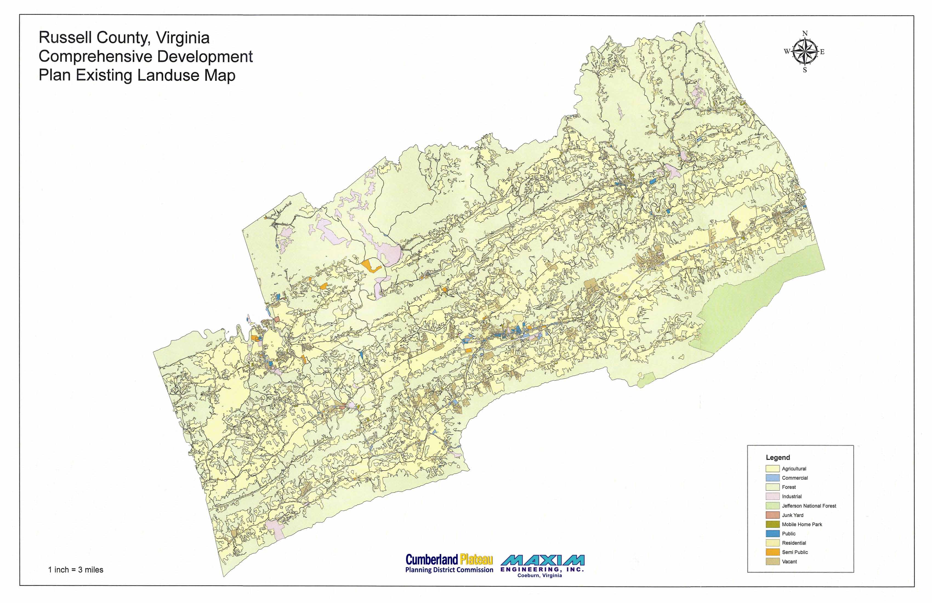

Slide 19



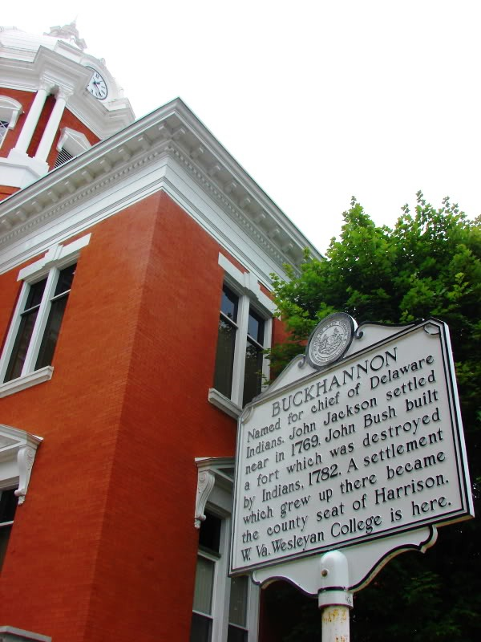
RUSSELL COUNTY
137 Highland Drive, Suite A
PO Box 1208
Lebanon, Virginia 24266
LANDFILL DEVELOPMENT FEASIBILITY
(MOSS III LANDFILL)
Charleston • Morgantown • Winchester, VA
PRESENTER:
David K. Paylor
Vice President of Environmental
Project #: 0103-22-0164
March 8, 2024

Slide 20

RUSSELL COUNTY ENGAGED POTESTA
Identify Health/Safety Issues (regarding citizens)
Evaluate the Feasibility of the Site as a Landfill
Address Unique Site Features
Address Environmental Concerns
Meet/Exceed State Regulations
20

Slide 21
SITE EVALUATION
REVIEWED FATAL FLAW SCREENING REPORT
Further Evaluation Proposed
  Stability of slopes/types of materials/dams
  Verification of limits of underground mining
  Geologic faults/seismic activity
  SITE VISIT
  Bowl-shaped depression
  Existing coal refuse
  Adjacent dams
21

Slide 22
SITE EVALUATION
LETTER REPORT WITH RECOMMENDATIONS
No issues identified that make the site “unpermittable”
Detailed evaluation/proper technical design are critical to addressing issues identified for further assessment
  RECOMMENDATIONS
  Landfill liaison
  Leachate collection/detection layers
    Gravity flow to outside landfill
    Adequate leachate treatment plan
    Remove ponded water
22

Slide 23
SITE EVALUATION
  RECOMMENDATIONS
    Remove unsuitable material
      Coal fine/soft soils
      Acceptable firm foundation
  Evaluate the suitability of coarse coal refuse
  Detailed Stability Analyses
    Natural soils
    Coarse coal refuse
    Existing coal refuse dam embankments
    Proposed liner system
    Landfill waste
23

Slide 24
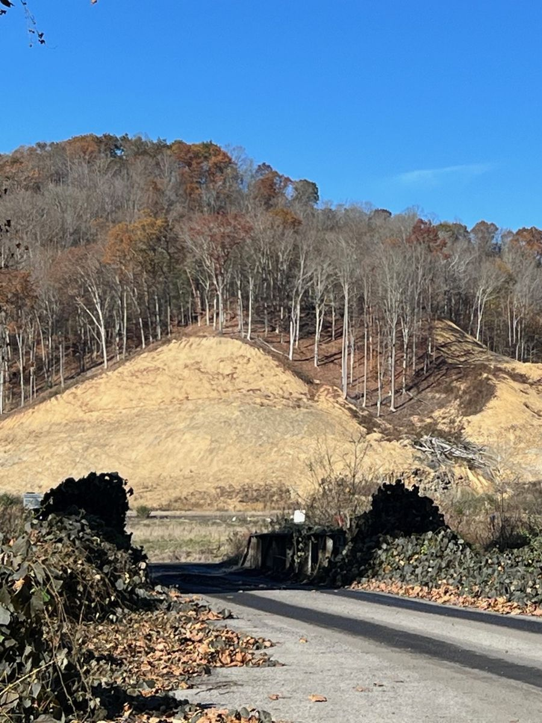
SITE EVALUATION
  RECOMMENDATIONS
  Mine Safety & Health Administration (MSHA)
    Approval for fills impacting Dams 1 and 2
    Evaluation of Underground Mining
      Horizontal/vertical location
      Height of mine void
      Angle of draw
24

Slide 25
ADDITIONAL REQUIREMENTS
  Design/implement mine stabilization program
    e.g., full roof contact grouting
    Slope stability for all components
      Prepared subgrade
      Coal refuse
      Landfill liner system
      Slopes/embankments of coal refuse fills/impoundments
      Natural ground slopes (under/adjacent to landfill)
      Temporary/final slopes of landfill (waste placement, cover material)
      Material strength parameters based on sampling/laboratory analyses
25

Slide 26
ADDITIONAL REQUIREMENTS
        Develop dewatering plan
        Evaluate bearing capacity, settlement/consolidation of subgrade, etc.
        Leachate storage
        Liner material able to elongate due to stress/strain from mine subsidence
        Meet/exceed Virginia Department of Environmental Quality Regulations
26

Slide 27
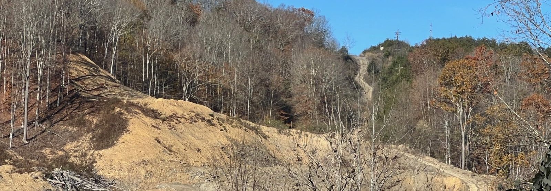
SUMMARY
  Meet/exceed Virginia Department of Environmental Quality Regulations
  No fatal flaws identified to date
  Detailed evaluation/proper technical design are critical to addressing issues identified for further assessment
27

Slide 28
Landfill Host Agreement – Economic Development Objectives
Multiple Economic Development Project Opportunities
Russell County IDA Building Site/Pad
Industrial Site located on Railroad Site
Employment - Jobs
Water & Sewer Infrastructure
Fiber Infrastructure

Slide 29
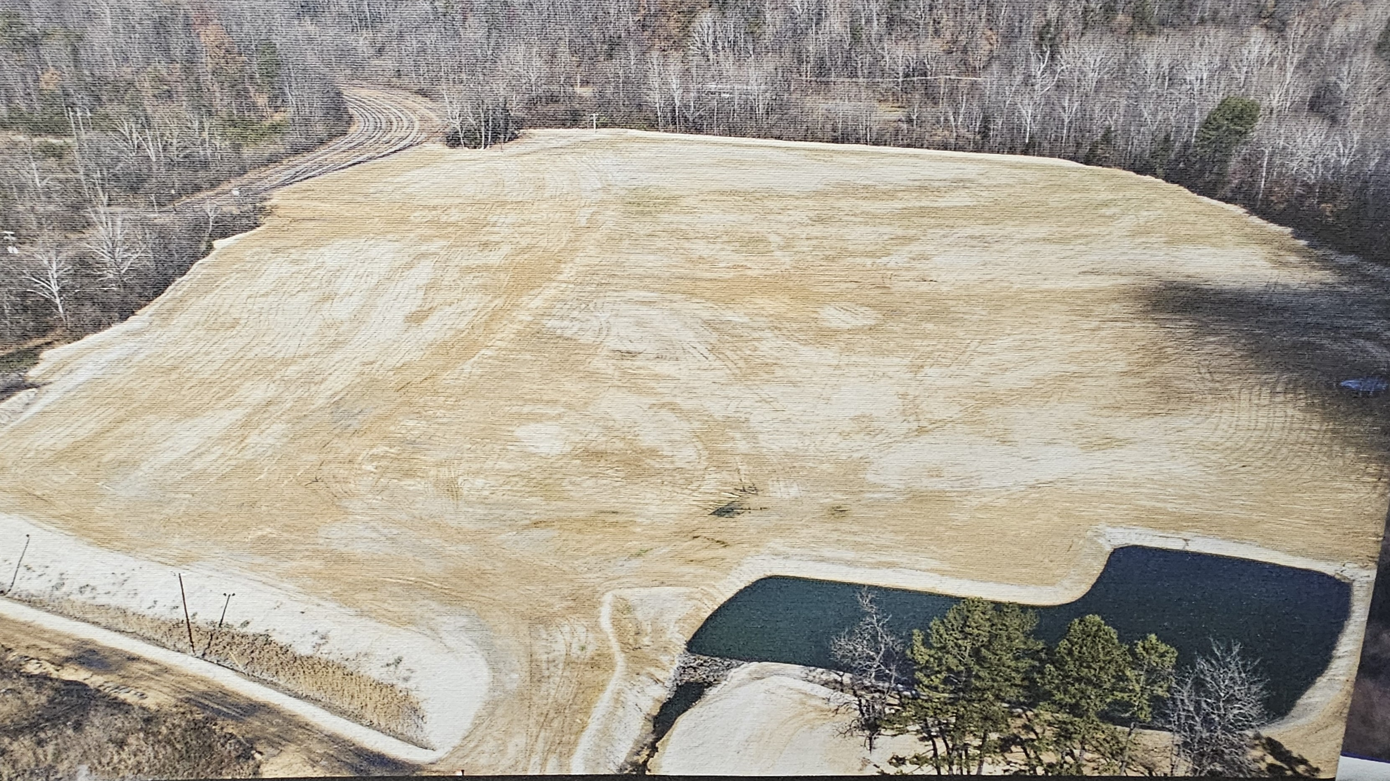

Slide 30
Landfill Host Agreement - Financial Objectives
Virginia Minimum Wage (Mandatory) - $13.50 (2025) & $15.00 (2026) - $87,000
Southwestern Virginia Regional Jail Increase (Mandatory) - $225,000
RC DSS – Foster Care & CSA Services Increase (Mandatory) - $375,000
2024 - 3.0% & 2025 – 3.8% Teacher Salary Increase (Mandatory) - $350,000
2024 & 2025 County Operation Inflationary Cost (Mandatory) – $145,000
RC Disposal & Transfer Station Increase (Contractual) - $520,000 (3-Year)
Regional Waste Authority Operational Deficit (Contractual) - $100,000
RC Fire & Rescue Services (Optional) & (Mandatory) - $245,000
School Resource Officers (Lebanon & Castlewood Elementary) - (Optional) - $177,973 (Salary/Benefits) & $45,650 (Training & Equipment)
RC Teacher Salary Increase (Optional) - $2,100,000
RC Real Estate Reassessment (Mandatory) – Projecting 40% - 50% Increase

Slide 31
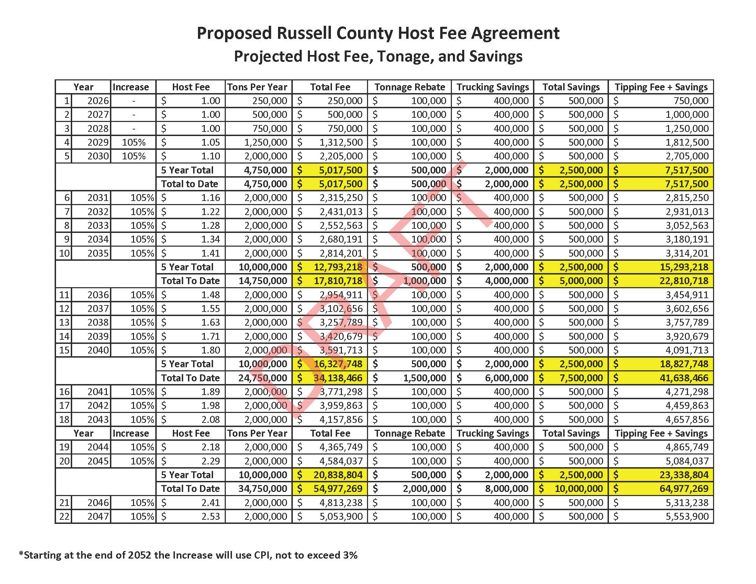
Landfill Host Agreement - Financial Objectives

Slide 32
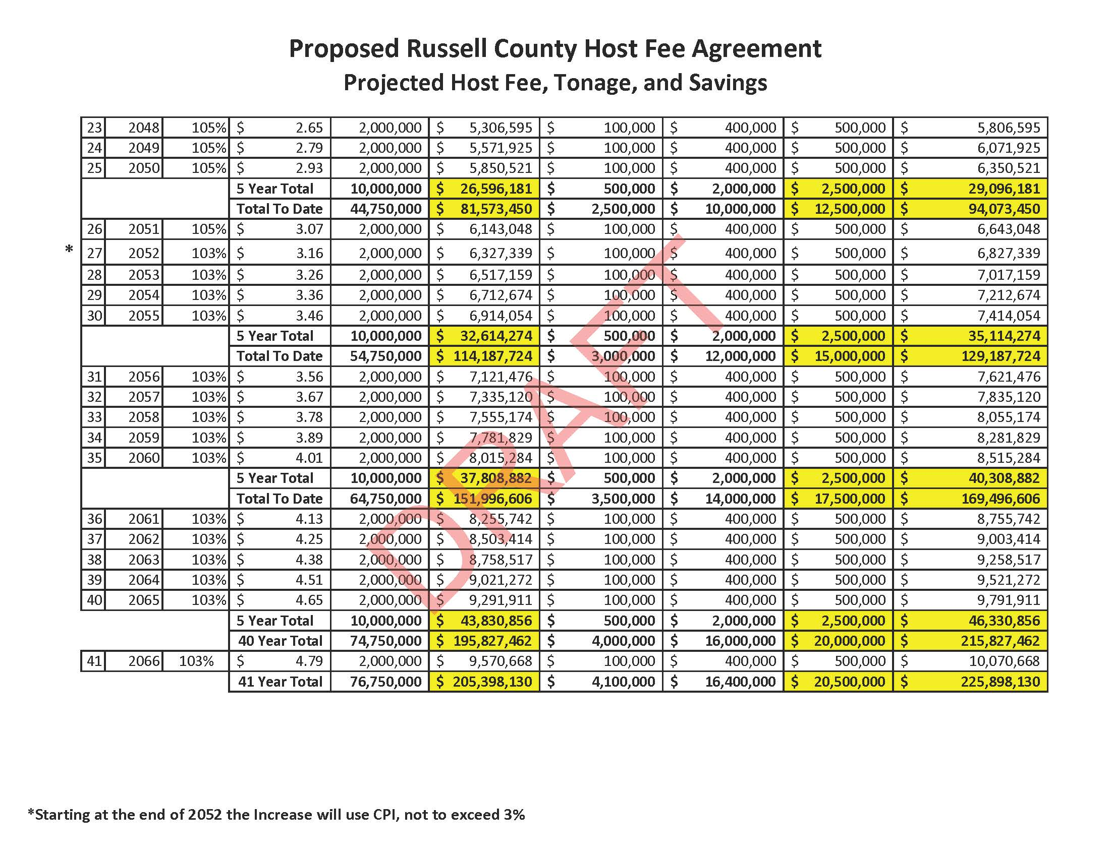
Landfill Host Agreement - Financial Objectives

Slide 33
Landfill Project – Scenarios
Scenario 1: County & NOVA Agree on the Host Agreement
1. Private Landfill in the County for Residential & Business Disposal
2. Cleanup Moss III Property – Environmental Concern – 118M Tons of Coal Refuse Removed
3. Economic Development Opportunities – Additional Jobs – 200+ Jobs
4. Financial Benefits – Host Fees, Real Estate, Machine & Tool, Personal Property, & Liner Tax
5. NO NEW TAXES
Scenario 2: County & NOVA Disagree on the Host Agreement
1. NOVA Continues with the Project & Files Legal Suit
2. No Host Agreement for County Protection – Legal, Environmental, or Financial
3. New Taxes and/or Disposal Fees must be considered
Scenario 3: County & NOVA Disagree on the Host Agreement
1. NOVA abandons the Moss III Project
2. Property will remain an Environmental Issue – 118M Tons of Coal Refuse will remain
3. Loss of Economic Development Opportunities
4. New Taxes and/or Disposal Fees must be considered

Slide 34
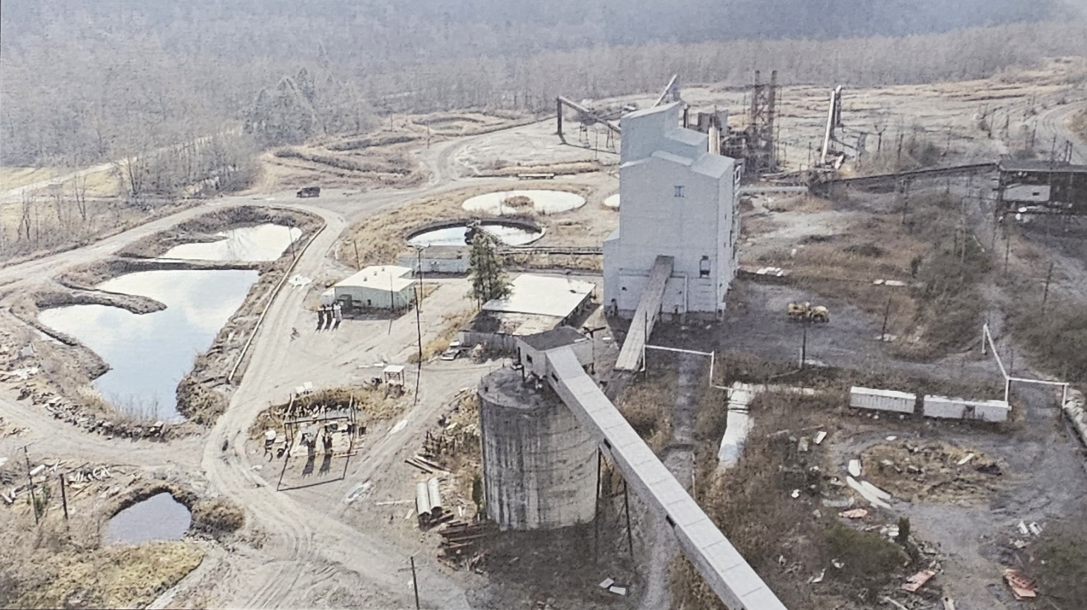

Slide 36
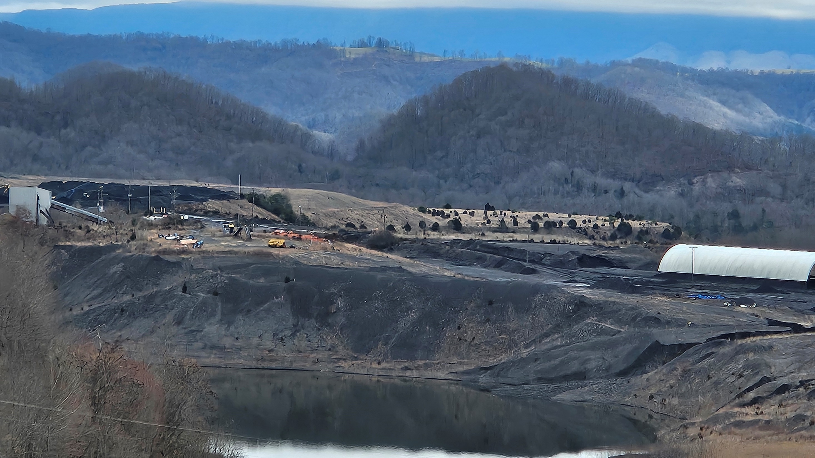
Includes silicon (Si), aluminum (Al), iron (Fe), calcium (Ca), magnesium (Mg), potassium (K), sulfur (S), titanium (Ti), phosphorus (P) copper, zinc (Zn), arsenic (As), selenium (Se), cadmium (Cd), mercury (Hg), and lead (Pb).

Slide 37
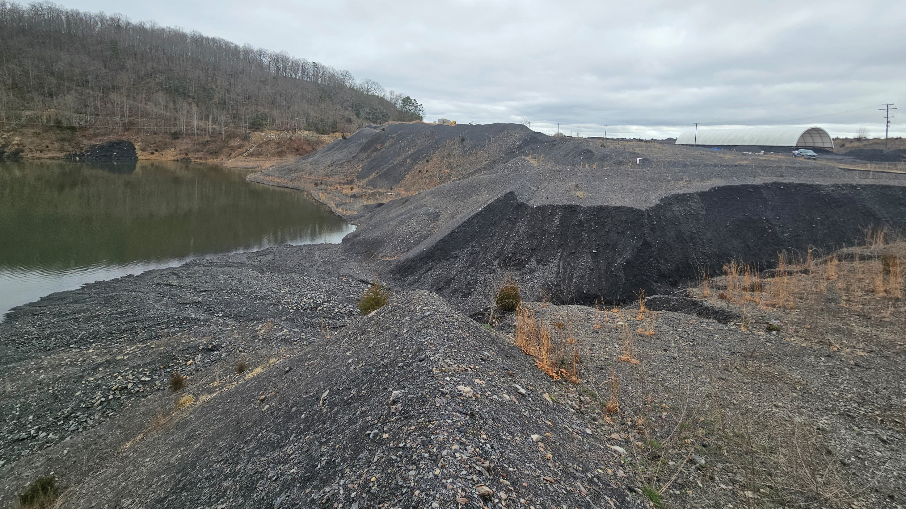

Slide 38
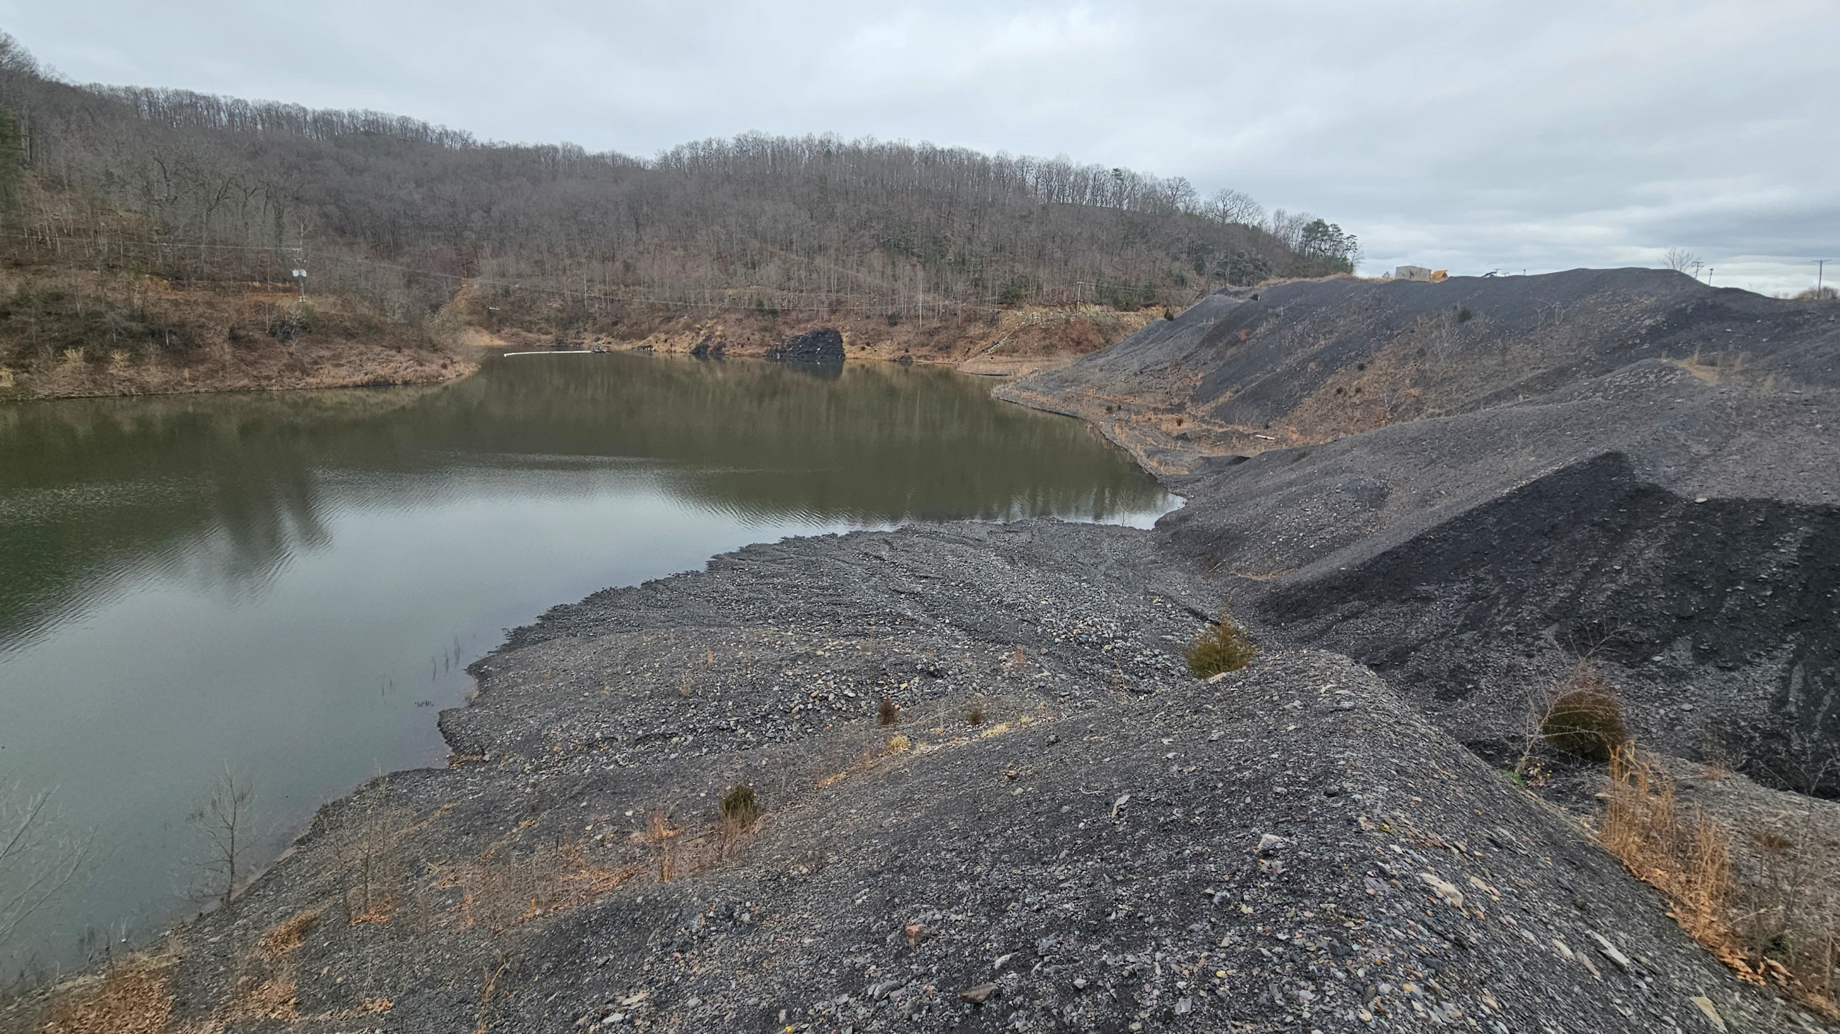

Slide 39
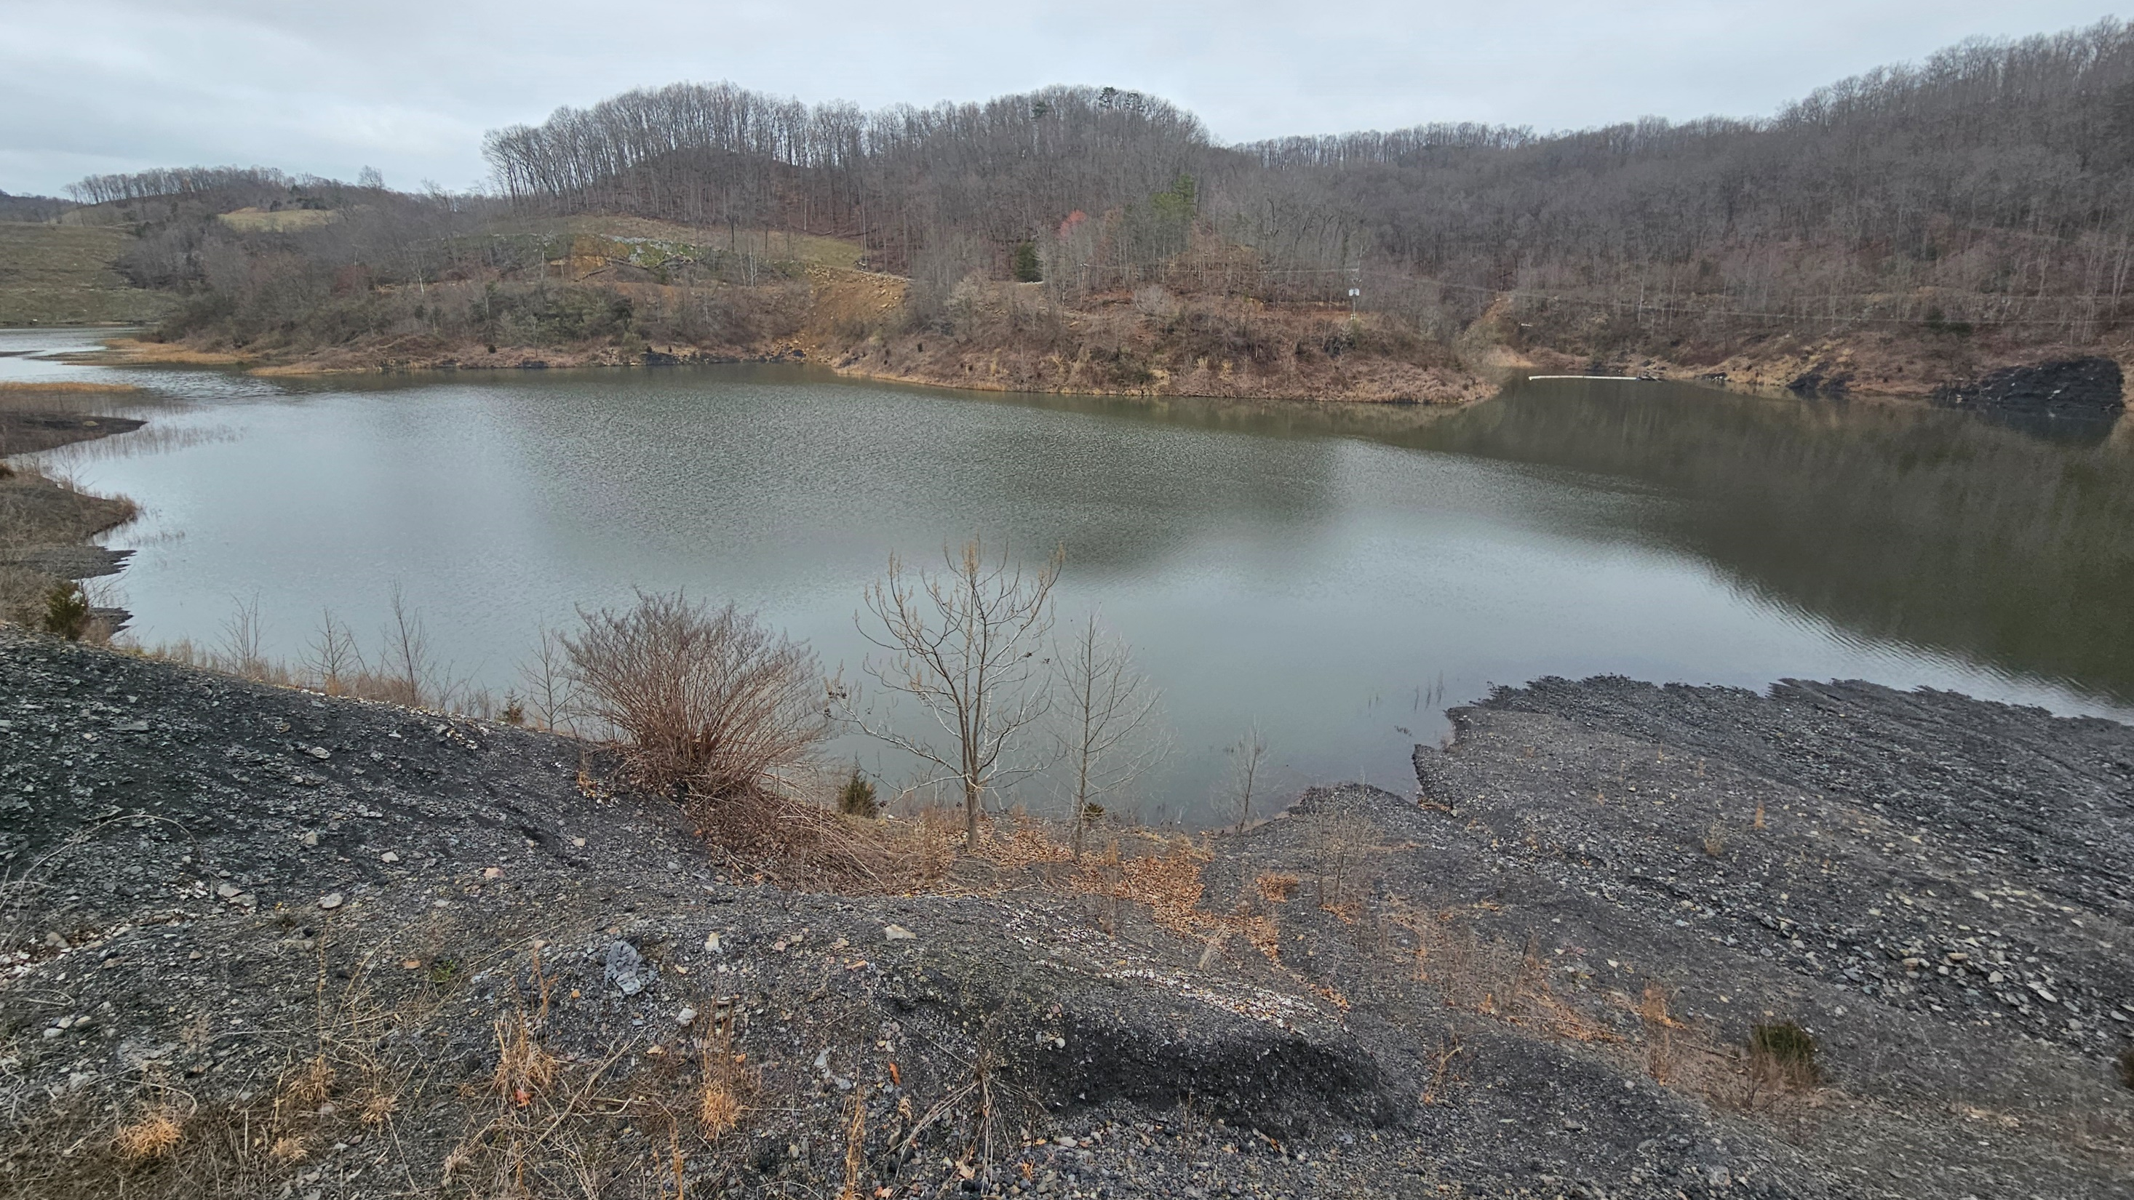

Slide 40
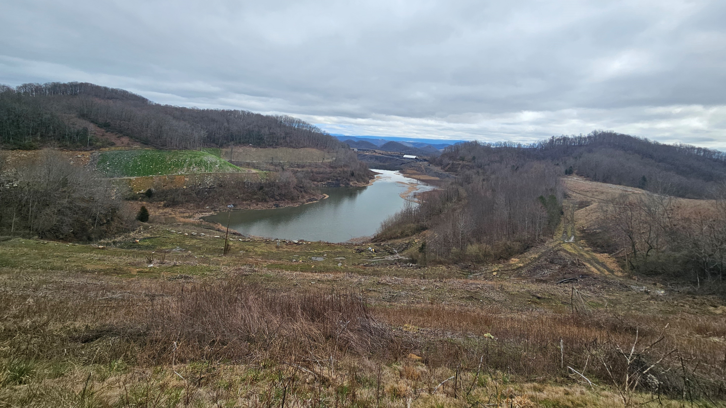

Slide 41
